Slide 1
GROUP 3
ADVENTURE WORKS
Kirthana Ashok Kumar Naik
Swarna B
Sales Analysis Report
Janhavi Shivajirao Patole
Balaji.B
Adventure Works Cycles | Power BI Dashboard Analysis
2010 – 2014 | Bikes, Accessories & Clothing
Nishita Thakur
Gaware Suhani Subhash
₹ 29.36M
₹ 12.08M
41.15%
18.48K
Singh Harsh Gyanendra
Total Sales
Net Profit
Profit Margin
Total Customers

Slide 2
Introduction
About Adventure Works
Business Requirements & KPIs
Large multinational manufacturing company headquartered in Bothell, Washington with 290 employees.
Business Goal
Increase Revenue, Cut Costs, Improve Targeting
Manufactures and sells metal & composite bicycles to North American, European and Asian markets.
KPIs
Sales Amount, Production Cost, Profit
Domain
Expanded with a Mexico manufacturing plant (est. 2000s) — sole producer of touring bicycles by 2001.
Retail / Manufacturing (Bicycles & Accessories)
Dataset Period
Goal: Increase market share, extend product availability online, and reduce production costs.
2010 – 2014 (5 Years)
Total Records
~60,400 Internet Sales Orders

Slide 3
Data Overview
FactInternetSales
DimCustomer
DimProduct
Core transactional data — sales orders, amounts, costs, dates
Customer demographics, geography, account info
Product catalog — names, categories, standard costs
~60,400 rows
18,484 records
606 products
DimProductCategory
DimSalesTerritory
DimDate
4 categories: Bikes, Components, Clothing, Accessories
Regional info — country, region, group
Full date dimension for time-series analysis
4 categories
11 territories
2010 – 2014
Key Columns: CustomerKey · ProductKey · SalesTerritoryKey · OrderDate · SalesAmount · TotalProductCost · OrderQuantity

Slide 4
Objectives & KPIs
Page 1 — Overview
Page 2 — Time Series Analysis
Analyze yearly sales trends to monitor business growth
Analyze yearly, quarterly, and monthly sales trends
Compare sales contribution across different region groups
Identify seasonal patterns and peak sales periods
Identify top-performing product categories by sales
Compare sales, production cost, and profit over time
Analyze customer distribution across regions
Monitor overall business growth and performance changes
Page 3 — Customer Analysis
Page 4 — Product & Regional Analysis
Analyze customer distribution by region and country
Analyze sales performance by product category
Identify repeat customers and retention trends
Identify top-selling and high-profit products
Top customers based on sales and profit contribution
Detect low-profit or loss-making products
Analyze purchasing behavior across different markets
Compare regional sales and profit performance

Slide 5
Process
01
02
03
04
05
Data Collection
Data Cleaning
Data Transformation
Data Modeling
Visualization (Power BI)
Gathered Adventure Works dataset — 7 tables including FactInternetSales, DimCustomer, DimProduct, DimDate, DimSalesTerritory
Handled null values, removed duplicate rows, standardized date formats and product category names using Excel & Power Query
Created calculated columns: Profit = Sales − Cost, Profit Margin %; built relationships between fact and dimension tables
Implemented Star Schema model in Power BI — FactInternetSales at center connected to all dimension tables
Built 4-page interactive dashboard: Overview, Time Series, Customer Analysis, Product & Regional Analysis

Slide 6
Analysis — Overview
Page 1
₹29.36M
₹17.28M
₹12.08M
41.15%
18.48K
Total Sales
Production Cost
Profit
Profit Margin
Total Customers
KEY INSIGHTS
Bikes dominate at 96.8% of total sales (₹28.32M); Road Bikes (₹14.5M) and Mountain Bikes (₹9.95M) are top sub-categories.
2013 was the peak year with ₹16.35M in sales — nearly 3× the 2011 figure. 2014 data appears partial.
USA (31.98%) and Australia (30.86%) account for nearly 63% of total customers globally.

Slide 7
Analysis — Time Series (Monthly Patterns)
Page 2
November
January
Peak Month
Lowest Month
₹993K avg
₹467K avg
+113%
Oct–Nov
Growth (Jan→Nov)
Seasonal Pattern
Jan to Nov growth
peak sales window
KEY INSIGHTS
January is the lowest month (₹467K avg); sales ramp sharply from May onwards reaching peak in November (₹993K avg).
October–November are the strongest months (₹972K–₹993K avg), indicating year-end buying behaviour.
June shows a surprising mid-year spike (₹979K) — possibly due to summer cycling season and promotions.
H1 (Jan–Jun) averages ₹675K/month vs H2 (Jul–Dec) at ₹886K/month — H2 outperforms H1 by 31%.

Slide 8
Analysis — Customer
Page 3
18,484
42.30%
19.43%
Total Customers
Top Country (US)
Top Region (Aus)
KEY INSIGHTS
USA leads with 42.30% of all customers (7,819), while Australia holds 19.43% (3,591) — together 62% of the customer base.
Europe (UK + Germany + France) contributes ~30% of customers (5,503) — a significant combined market.
Canada accounts for 8.50% of customers — the smallest market despite being North American, with significant growth headroom.
Retention analysis suggests customer churn increases after the 3rd order — loyalty programs are recommended post-purchase.

Slide 9
Analysis — Product & Regional
Page 4
Low Profit Products (Lowest Margin %)
Low Profit Products (Lowest Margin %)
KEY INSIGHTS
Product
Product
Margin %
Margin %
Mountain-200 series dominates all top 5 best-sellers — all in the ₹1.29M–₹1.37M range, strong brand concentration.
AWC Logo Cap
AWC Logo Cap
23.0%
23.0%
Long-Sleeve Logo Jersey, L
Australia leads all regions at ₹9.06M, surpassing even the entire US Southwest (₹5.72M) by 58%.
Long-Sleeve Logo Jersey, L
23.0%
23.0%
Long-Sleeve Logo Jersey, M
Long-Sleeve Logo Jersey, M
23.0%
23.0%
Accessories & Clothing account for <3% of total revenue — prime candidates for promotional upselling strategies.
Short-Sleeve Classic Jersey, XL
Short-Sleeve Classic Jersey, XL
23.0%
23.0%
AWC Logo Cap & Jerseys have only 23% profit margin — the lowest in the catalog. Price revision or bundling recommended.

Slide 10
Recommendations & Insights
Boost Accessories & Clothing Sales
Launch Customer Loyalty Program
Seasonal Campaign Optimization
Accessories (2%) and Clothing (1%) are under-monetized. Bundle deals and cross-sell campaigns alongside Bikes can increase basket value by an estimated 15–20%.
Customer churn rises after the 3rd order. A tiered loyalty program — offering discounts, early access, or service benefits — can improve retention rate significantly.
April consistently shows the lowest sales. Targeted promotions or limited-edition launches in Q2 can smoothen the revenue curve and reduce seasonal revenue dips.
Expand Canada Market Presence
Review Low-Profit Products
Double Down on Mountain-200 Series
Canada contributes only 6.74% of customers despite being a major North American market. Localized marketing campaigns can unlock significant growth potential.
Products like Patch Kit (4,570 units) and AWC Logo Cap (4,530 units) generate high volume but low profit. Consider price revision, bundling, or discontinuation.
The Mountain-200 series accounts for all top 5 best-selling products. Expanding color/size variants and premium positioning can further grow this segment.

Slide 11
Conclusion
Summary of Findings
Challenges & Learnings
Revenue Peak:
Challenges
2013 was the highest sales year at ₹16.35M — strong execution in product and market expansion.
Large dataset (~60K rows) required careful query optimization in SQL.
Category Dominance:
Multiple dimension tables required careful Star Schema modeling in Power BI.
Bikes contribute 96.8% of all revenue; accessories and clothing represent untapped cross-sell potential.
Geographic Strength:
2014 data is partial — year-over-year comparisons needed contextual adjustment.
USA and Australia together drive 63% of customers and ~62% of total sales.
Learnings
Retention Gap:
End-to-end analytics pipeline: raw data → SQL → Power BI → insight.
Customer churn spikes after the 3rd order — a critical retention window that needs addressing.
Product Concentration:
Importance of data relationships and calculated columns in DAX.
Mountain-200 series (5 variants) dominates the top product list — both a strength and a risk.
Business storytelling through structured, multi-page dashboard design.
Seasonal Opportunity:
Identified real revenue levers through product & regional segmentation.
Nov–Dec peak and April dip present clear windows for promotional intervention.

Slide 12
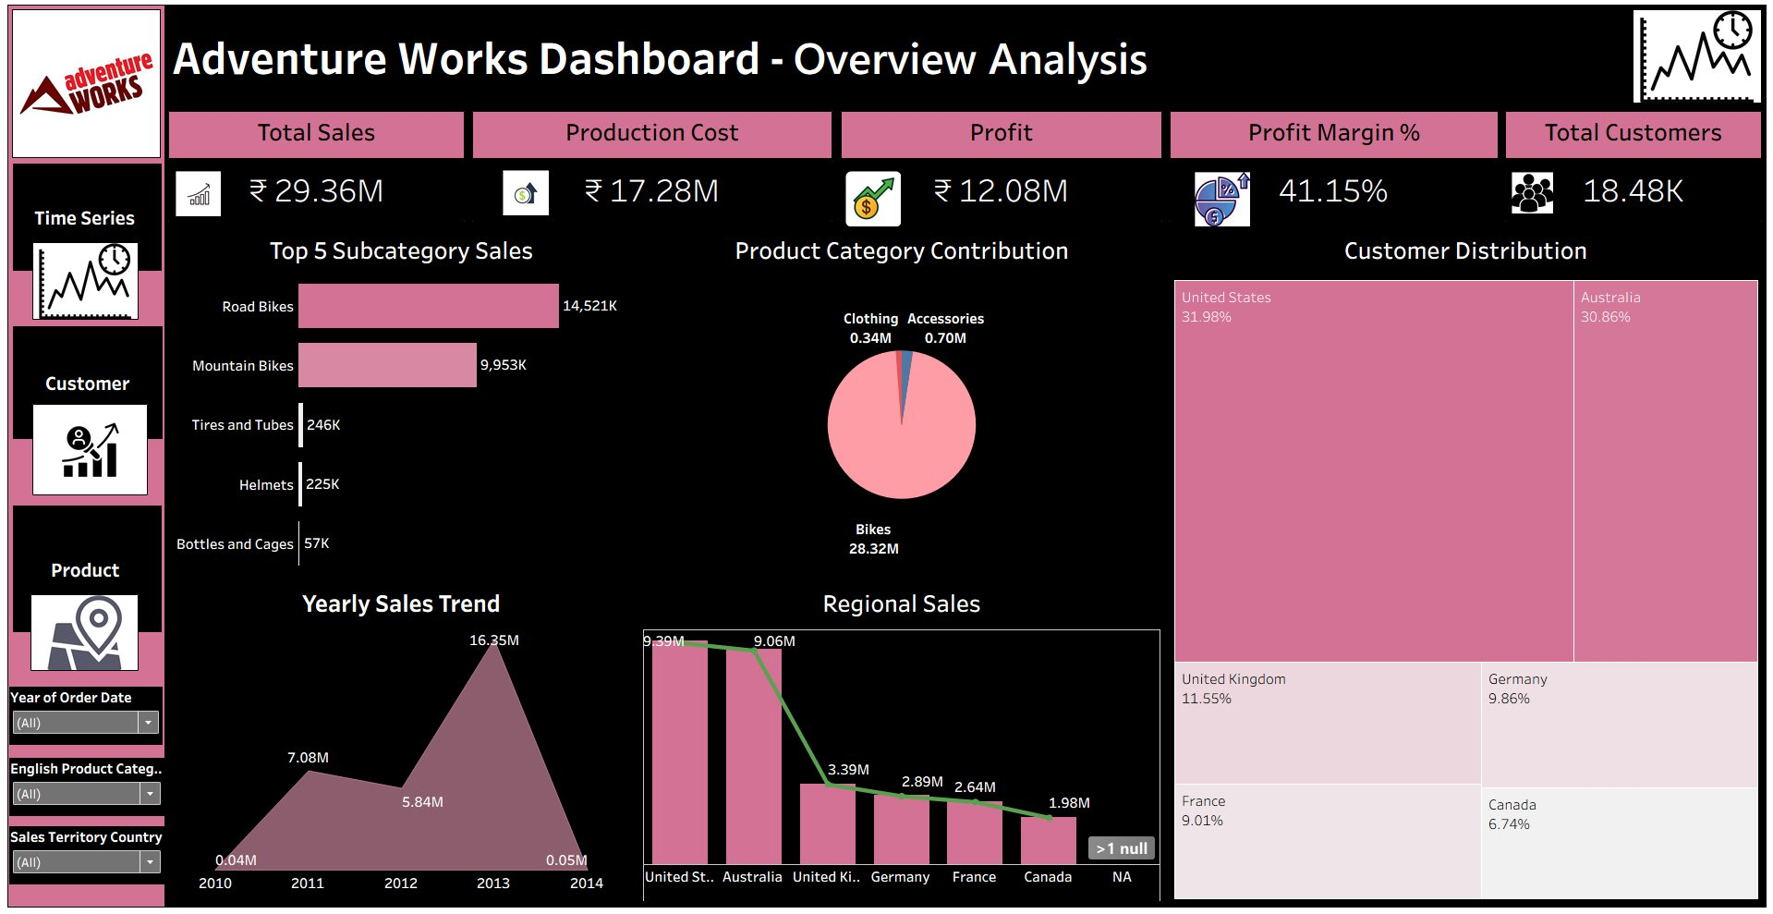
Dashboard Snapshot
Thank You!
Group 3 | Data Analytics Project
Kirthana Ashok Kumar Naik
Swarna B
Janhavi Shivajirao Patole
Balaji.B
Nishita Thakur
Gaware Suhani Subhash
Singh Harsh Gyanendra

